Slide 1
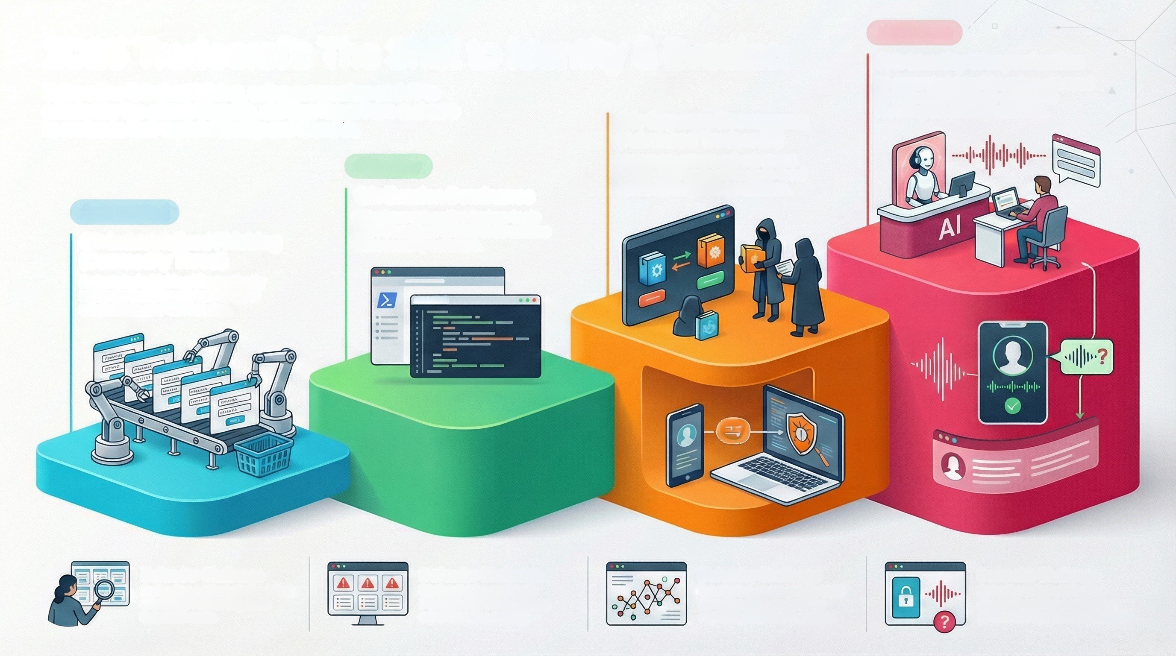
2025 Tradecraft: The Shift to Identity & Evasion
Cybercrime is industrializing, using automation and Al to
accelerate the attack lifecycle, shifting focus from malware
to methods that exploit identity and blend in.
Al-Driven
Q4: Identity Weaponization
Al-generated deepfake voices are used
to trick corporate help desks into
resetting executive passwords.
Q3: Spyware Resurgence
(Advanced Tradecraft)
Mercenary groups sell advanced
commercial spyware to state-level
actors for targeted survelliance.
Stealthy
Q2: Evasion Dominance
Attackers use native system tools
like PowerShell to hide their actions
from security software.
Automated
Q1: Industrialized Phishing
(Commodity Threat)
Automated phishing kits perfectly
replicate banking portals to steal
credentials and MFA codes.
PowerShell
Defender Challenge
Defending against pixsl-perfect
credential harvesting at an
industrial scale.
Defender Challenge
Distinguishing malicious
PowerShell from legitimate
administrative activity.
Defender Challenge
Defender Challenge
Securing voice verification
Countering commercially-soid
surveillance tools used by
channels against convincing
sophisticated threat groups.
Al-driven impersonation attacks.

